Slide 1
Accelerator programme Interactive visualisation for the Scottish Burden of Diseases
Maite Thrower
Senior Analyst from Public Health Intelligence – ISD (NHS National Services Scotland)
&
Caterina Constantinescu
Mentor and Data scientist from the Datalab

Slide 2
Project
The aim was to produce an interactive data visualisation to engage different audiences.
The Global Burden of Diseases has already developed examples of interactive visualisation.
Scottish Burden of Disease had already developed a static bubble chart.

Slide 3

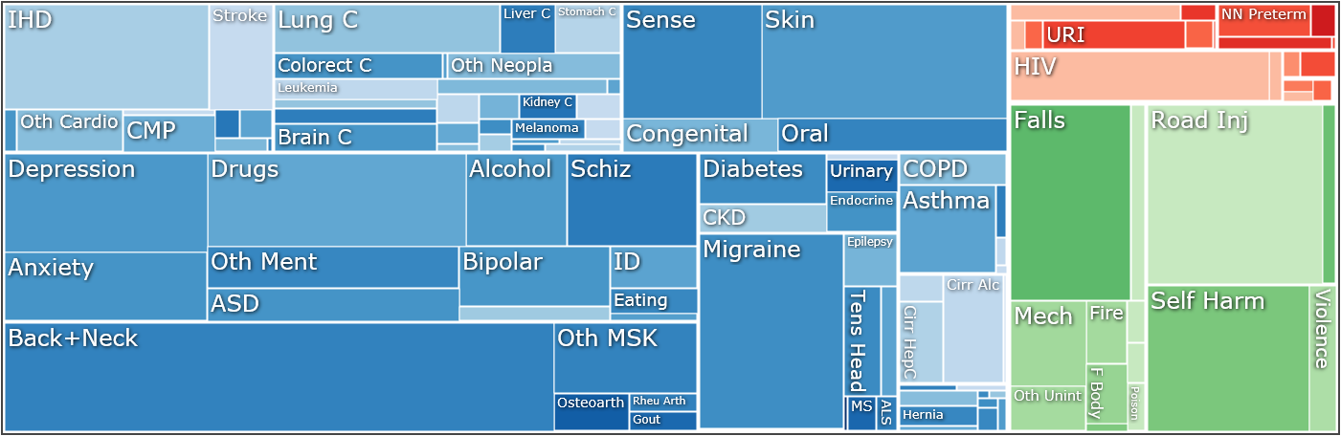
Global Burden of Disease Study (GBD) by Institute for Health Metrics and Evaluation, GBD 2016 , 2018 University of Washington

Slide 4
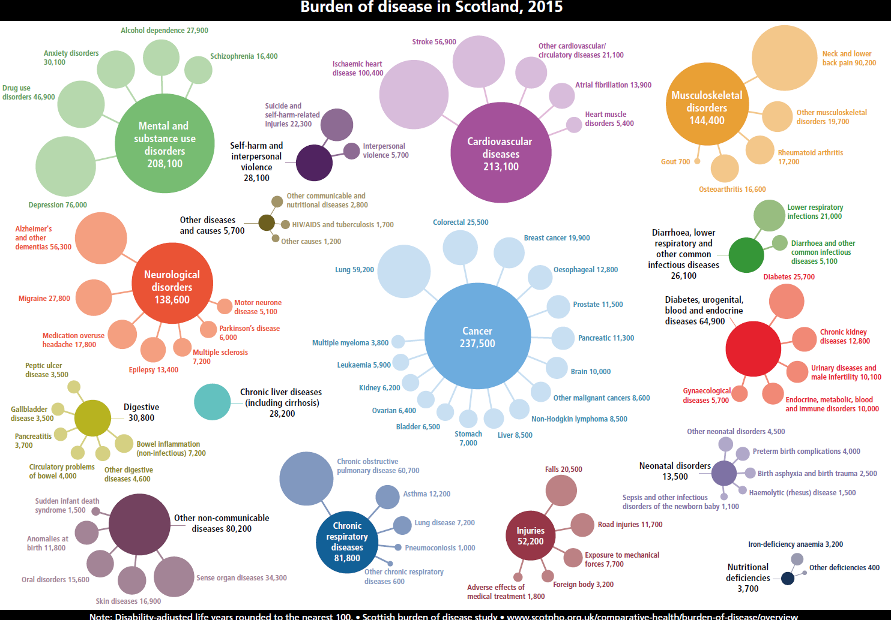
SBoD Data Visualisation

Slide 5
Scottish Burden of diseases
Burden of disease is a measure of the health of the population
It aims to quantify the difference between:
a) living to old age in good health
b) and the situation in which healthy life is shortened by illness, injury, disability and early death.

Slide 6
Key measures
DALY ( disability-adjusted life year) is the measure used to describe the overall burden of disease and combines:
Fatal burden: years lost because of early death – years of life lost (YLL)
Non-fatal burden: years lost because they are lived in less than ideal health – years lived with disability (YLD)
DALY
YLL
YLD

Slide 7
Development of the visualisation
First objective: to produce a static tree map of the burden of diseases with ggplots.
Mentoring: brain storming for the visualisation design, technology to use, learning program, resources such as: website, tutorials etc.
Working once a week with mentor Caterina Constantinescu from Datalab.

Slide 8
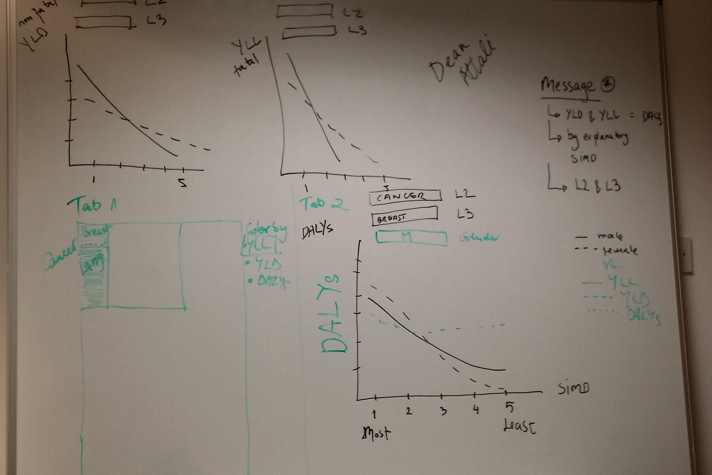
First draft...a way to go!

Slide 9
Accelerator journey starts....
How to prepare data in R,
How to produce charts and plots in ggplots.
How to create an app with Shiny.
How to produce three different plots in Shiny by different reactive variables.
And move from a static tree map to a Interactive Data visualisation with Shiny!

Slide 10
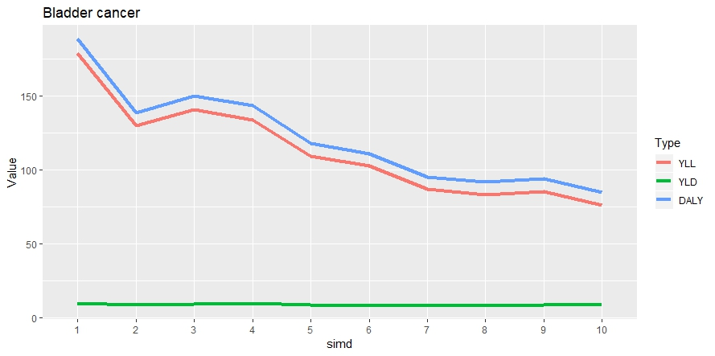
Developing plots

Slide 11
Final interactive visualisation
User able to filter data by:
Group of disease “Disease Level II”(e.g. Cancer)
Individual diseases “Disease Level III” (e.g. Lung cancer)
Measure: DALYs, YLL (fatal), YLD (non-fatal)
Deprivation (SIMD) from 1 most deprived to 10 least deprived.

Slide 12
Final interactive Visualisation
Outputs:
Tree map: Big picture for the SBoD by diseases/conditions.
Heatmap: Visualisation by group of diseases (e.g mental and substance use disorders)
Line plot: Individual diseases by group age, sex and deprivation.

Slide 13
Design of a shiny app
Shiny is a package from RStudio that can be used to build interactive web pages with R.
Every Shiny app is composed of a two parts: a web page that shows the app to the user, and a computer that powers the app.
UI: User Interface also called web page
Server
Shiny App
Powers the app
Computer/server
Inputs
Outputs
All the code to make the app reactive
While that may sound scary because of the words “web pages”, it’s geared to R users who have 0 experience with web development, and you do not need to know any HTML/CSS/JavaScript.

Slide 14
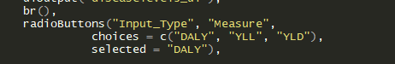
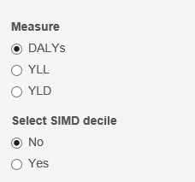
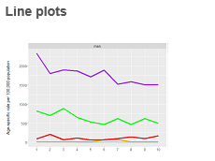
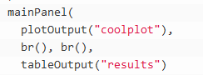
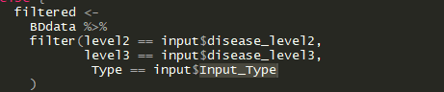
UI: User interface
It is just a web document that the user gets to see, it’s HTML that you write using Shiny’s function
The UI is responsible for creating the layout of the app and telling Shiny exactly where things go.
You add all your inputs e.g. numeric input, select input, etc…
You add all your outpurs e.g. graph, map, a table, etc
https://shiny.rstudio.com/images/shiny-cheatsheet.pdf
In the UI you also created your outputs: plot, table
Server
The server is responsible for the logic of the app; it’s the set of instructions that tell the web page what to show when the user interacts with the page
Make an output to react to an input.
Reactivity: it means that when the value of a variable x changes, then anything that relies on x gets re-evaluated

Slide 15
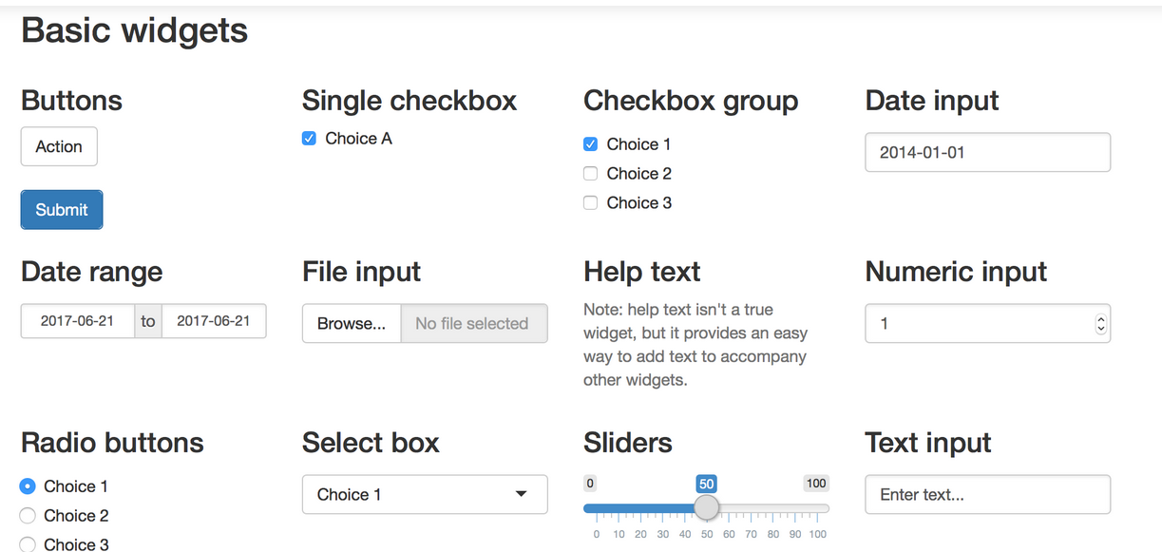
Examples of inputs in shiny

Slide 16
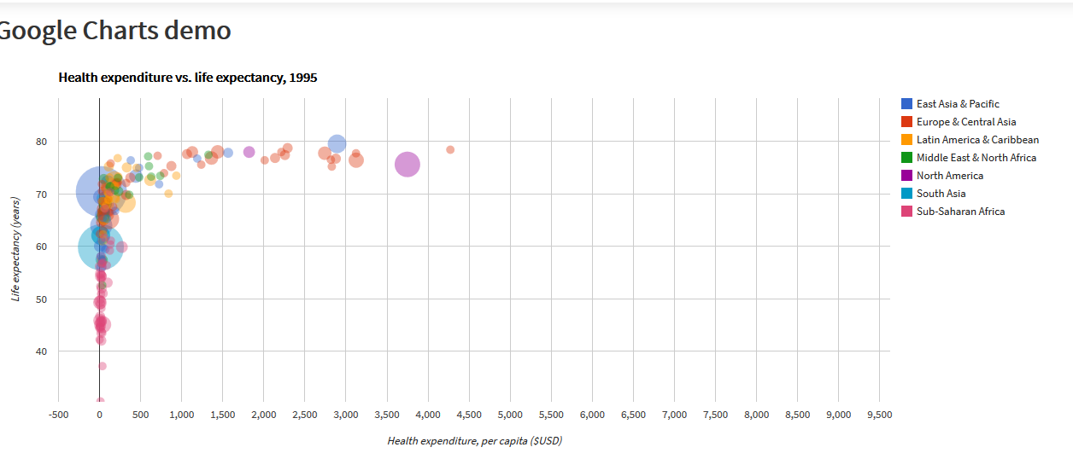
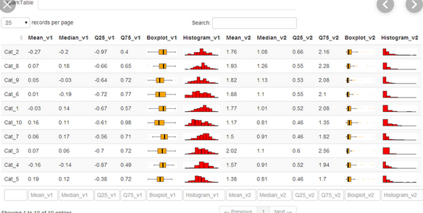
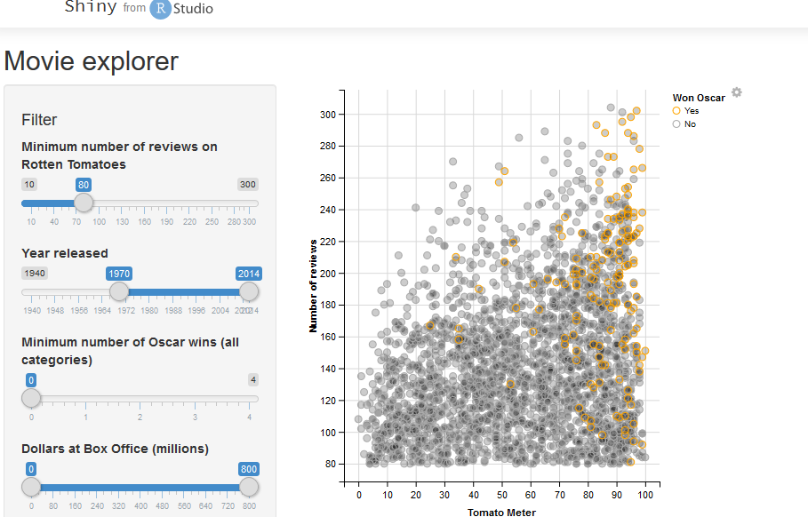
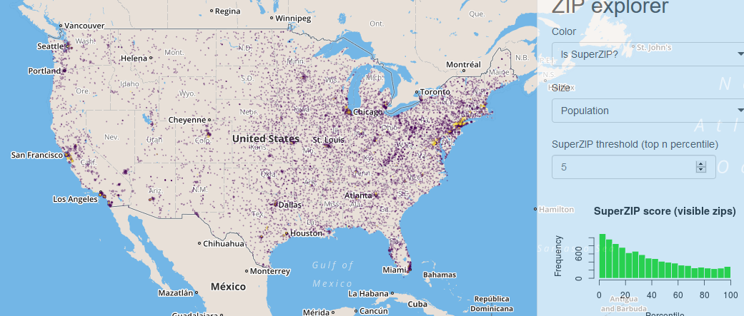
Examples of output examples

Slide 17
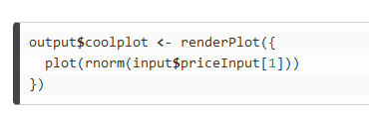
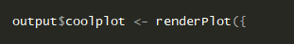
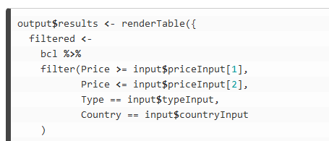
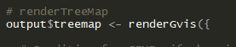
Server: writing the server function
The server function is always defined with two arguments: input and output
Inputs is a list you will read values from and output is a list you will write values to
Inputs will contain the values of all the different inputs at any given time, and output is where you will save output objects (such as plots and tables) to display in your app.

Slide 18
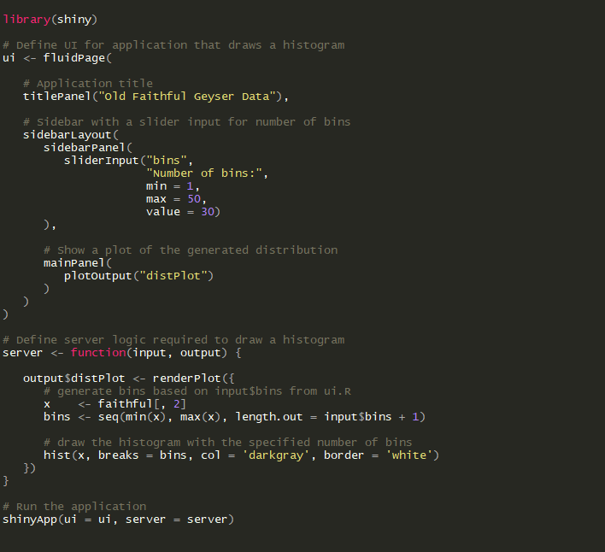
The final shiny app

Slide 19
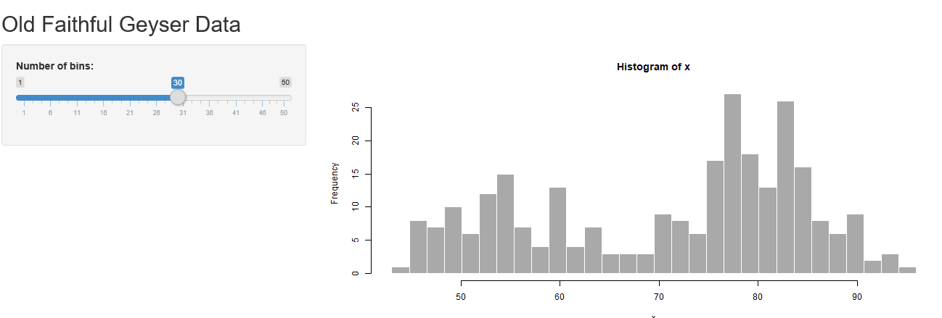
Display of final shiny app

Slide 20
The Scottish Burden of Diseases app

Slide 21
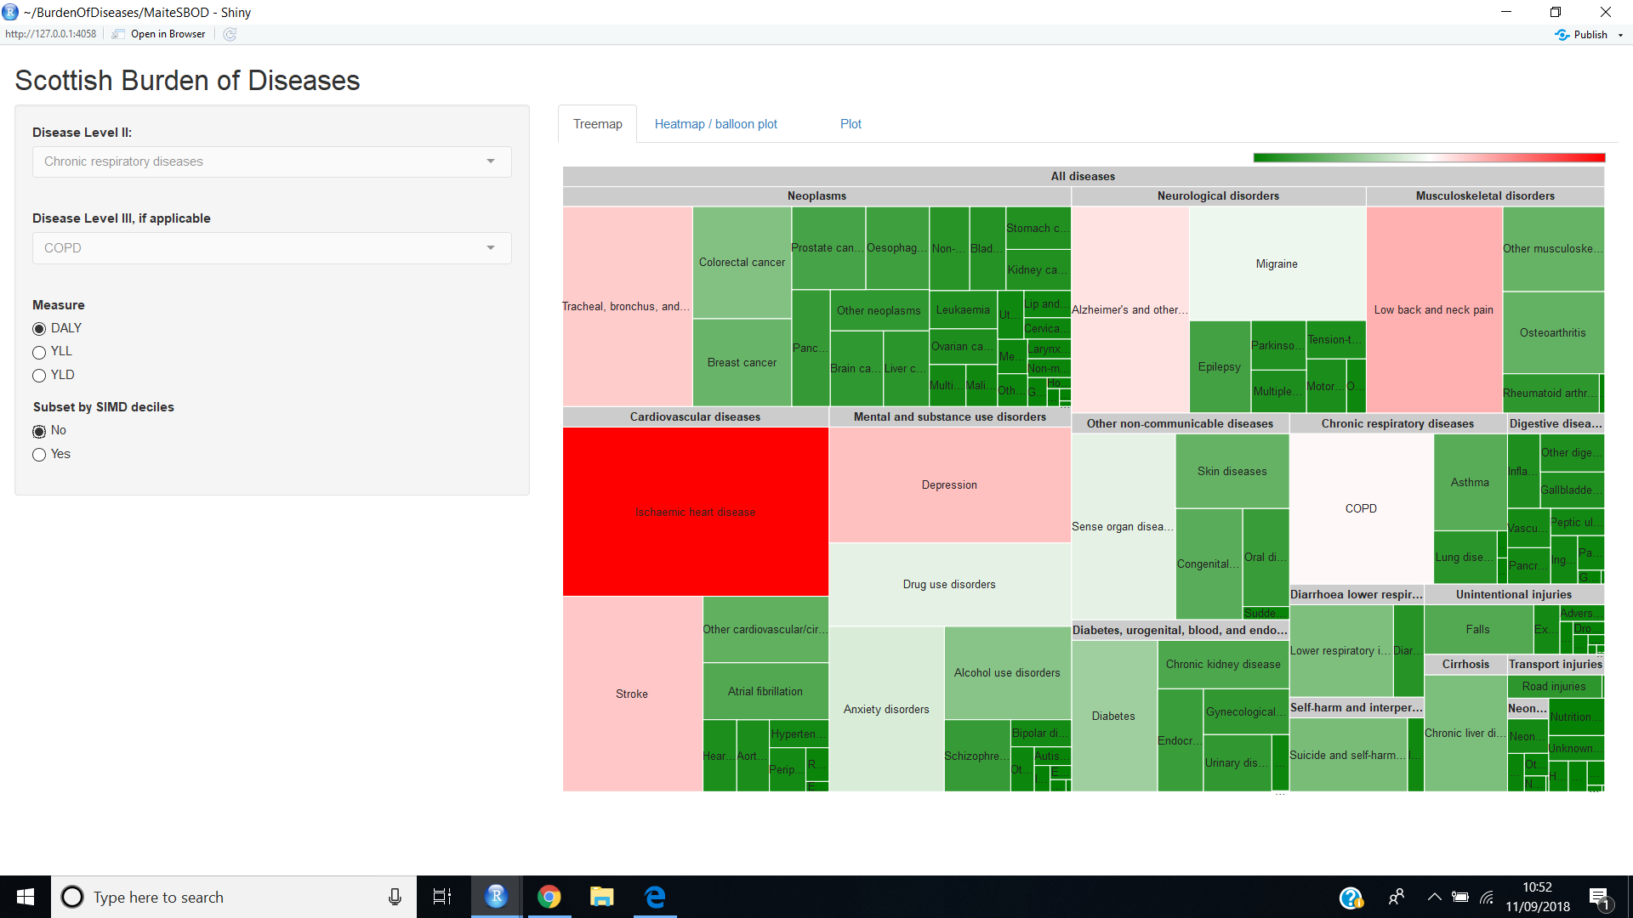
Scottish Burden of Diseases: Treemap by DALYs (disability-adjusted life year)
SIMD: The Scottish Index of Multiple Deprivation
1 “Most deprived areas” and 10 “Least deprived areas”

Slide 22
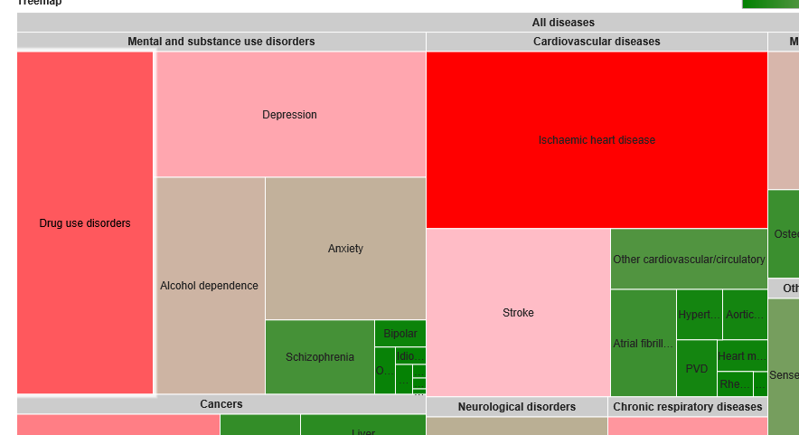
Treemap (shiny)
Treemapping is a method for displaying hierarchical data by using nested rectangles
A rectangle's area in a treemap is proportional to the data it shows.
Using colors and sizes that show the data variability helps to quickly see patterns that are difficult to observe from other types of visualizations
treemaps help to show lots of information without cluttering our vizualization and hence they are a nice way of creating interactive graphs.

Slide 23
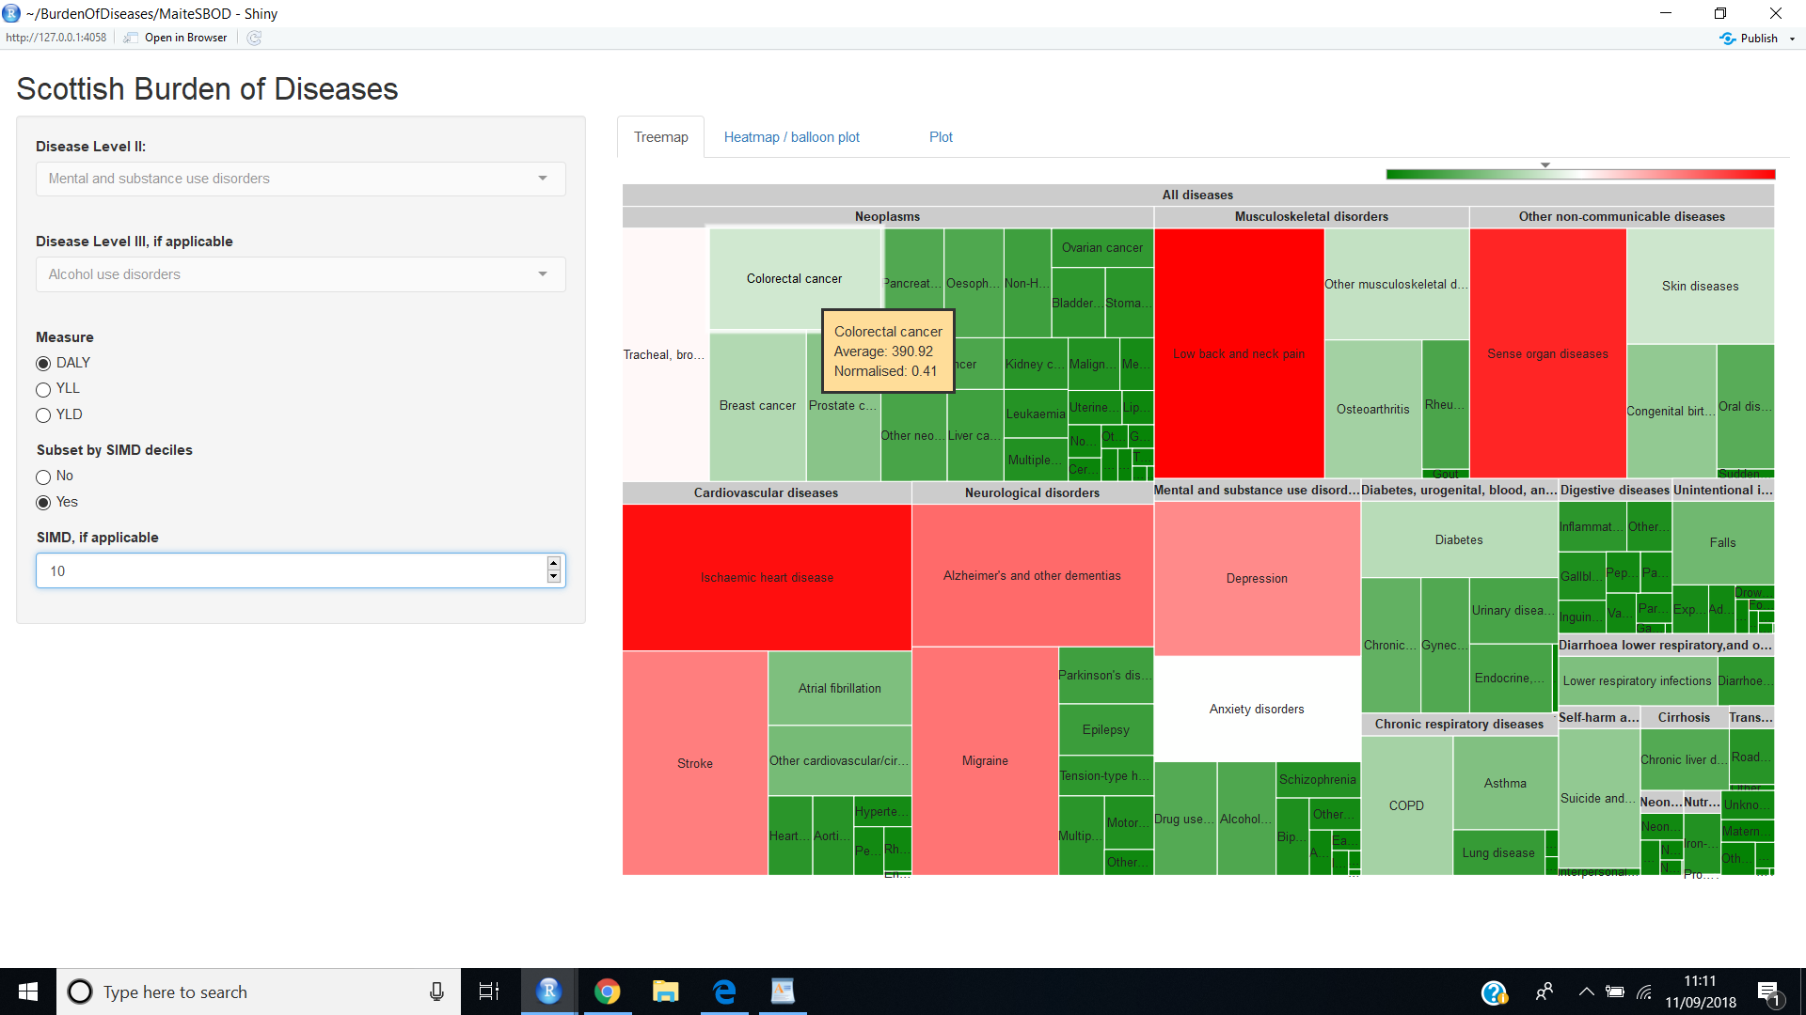
Scottish Burden of Diseases by wealthiest areas
SIMD: The Scottish Index of Multiple Deprivation
1 “Most deprived areas” and 10 “Least deprived areas”

Slide 24
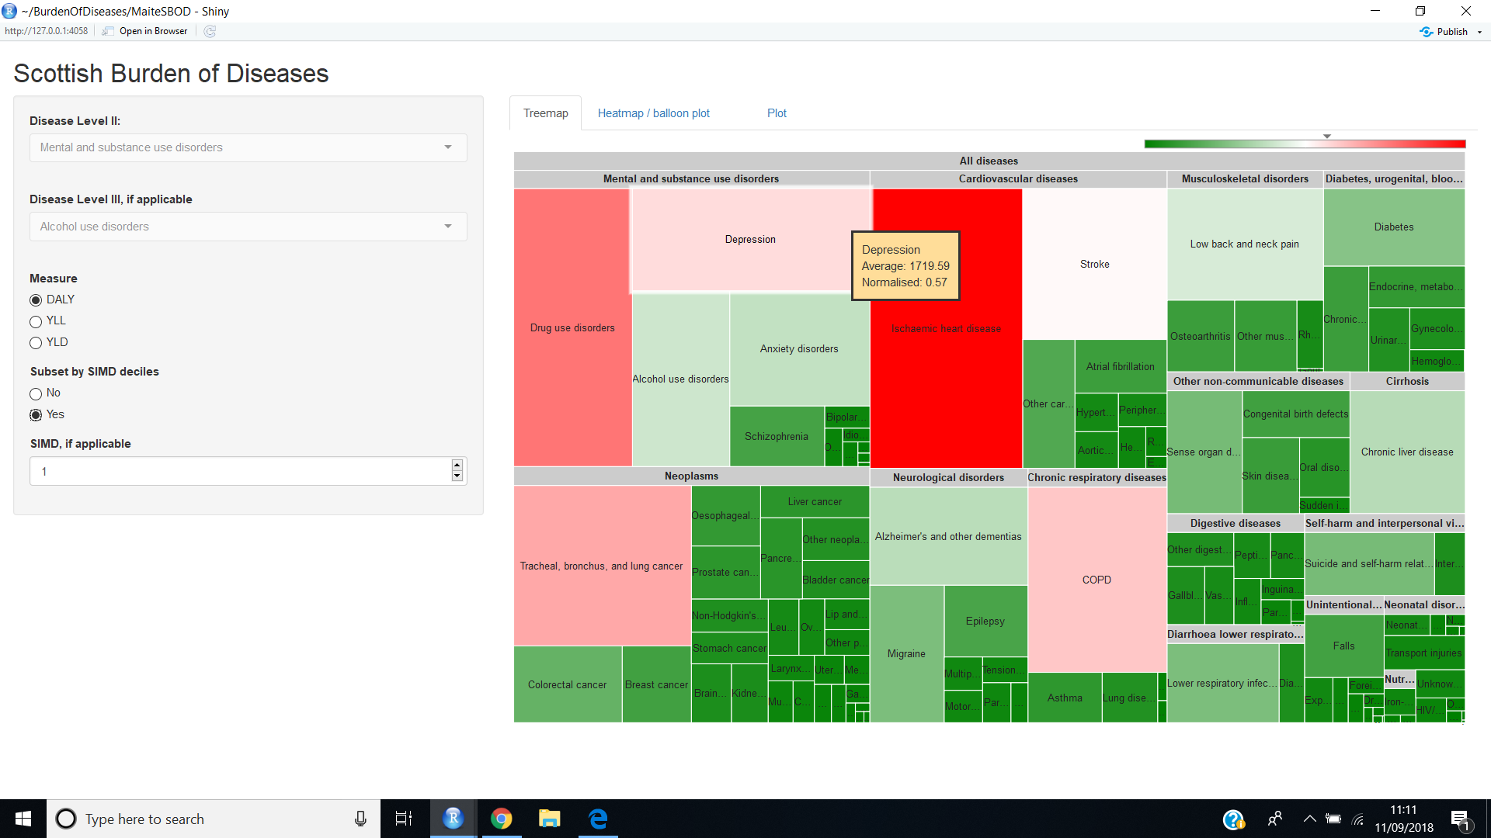
Scottish Burden of Diseases by poorest areas
SIMD: The Scottish Index of Multiple Deprivation
1 “Most deprived areas” and 10 “Least deprived areas”

Slide 25
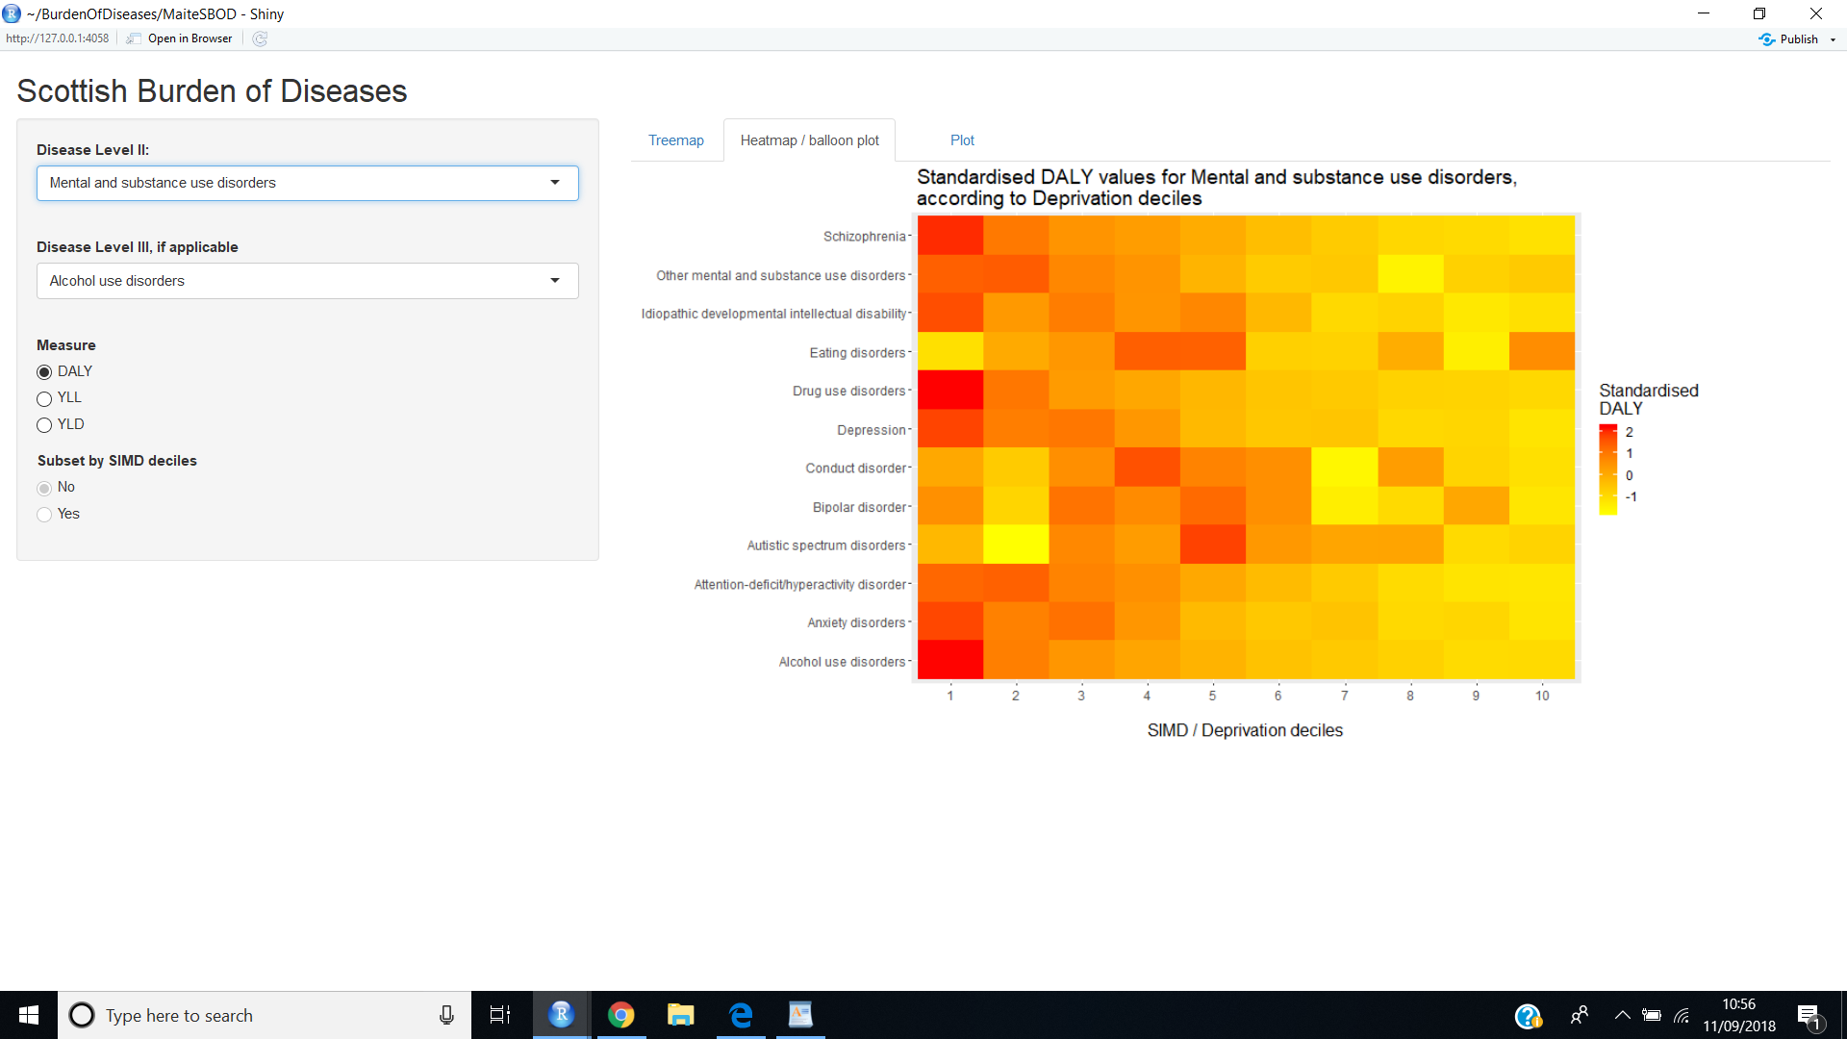
Scottish Burden of diseases: Heatmap by group of diseases and DALYs
SIMD: The Scottish Index of Multiple Deprivation
1 “Most deprived areas” and 10 “Least deprived areas”

Slide 26
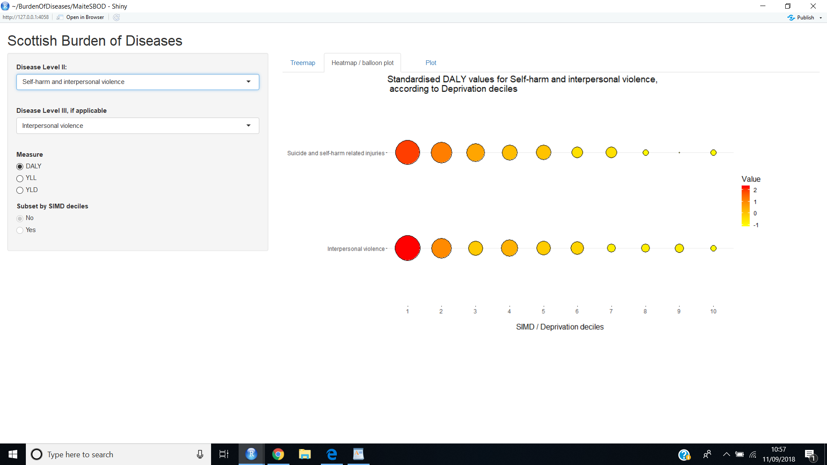
Scottish Burden of Diseases: self-harm and interpersonal violence group displayed by balloon plot
SIMD: The Scottish Index of Multiple Deprivation
1 “Most deprived areas” and 10 “Least deprived areas”

Slide 27
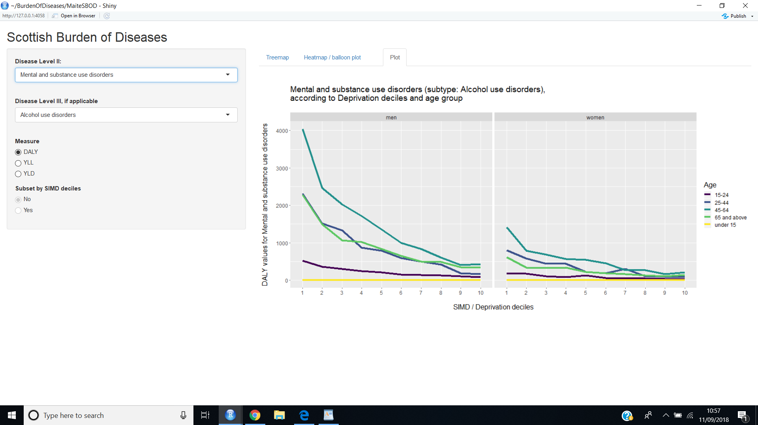
Scottish Burden of Diseases: Alcohol use disorder by genre, age group and deprivation deciles ( Line plots by DALYs)
SIMD: The Scottish Index of Multiple Deprivation
1 “Most deprived areas” and 10 “Least deprived areas”

Slide 28
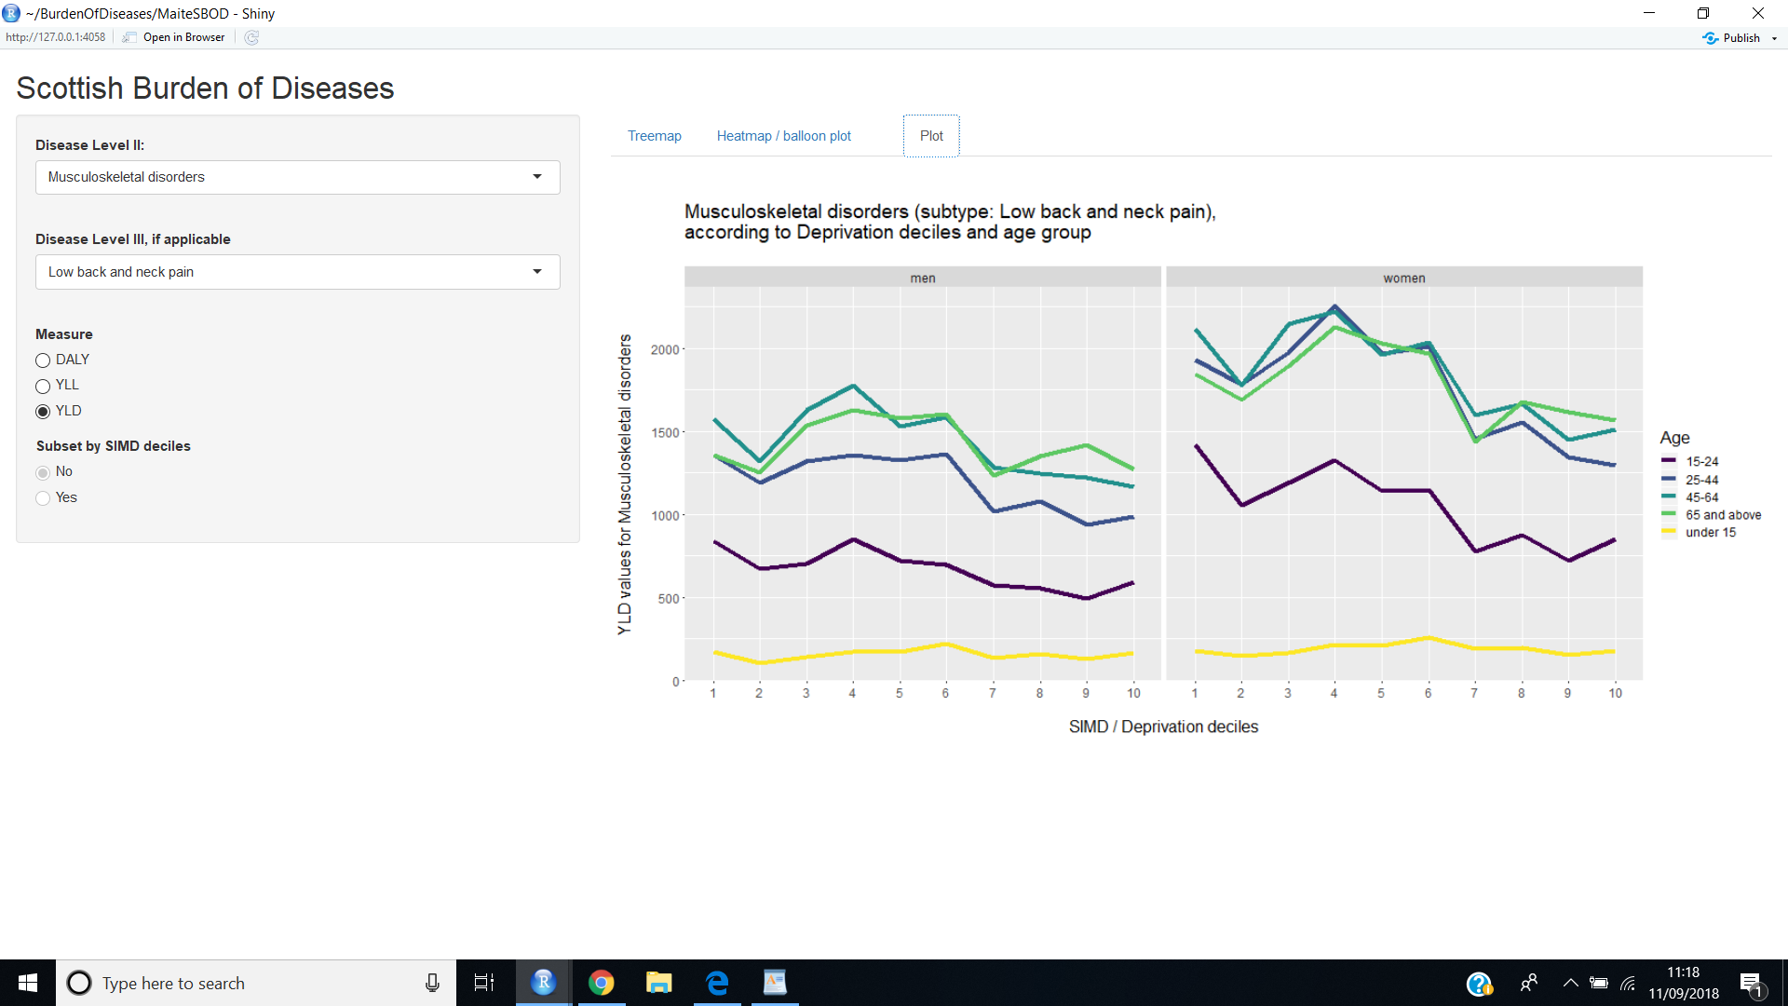
Scottish Burden of Diseases: Low back and neck pain by genre, age group and deprivation deciles ( Line plots by YLD)
SIMD: The Scottish Index of Multiple Deprivation
1 “Most deprived areas” and 10 “Least deprived areas”

Slide 29
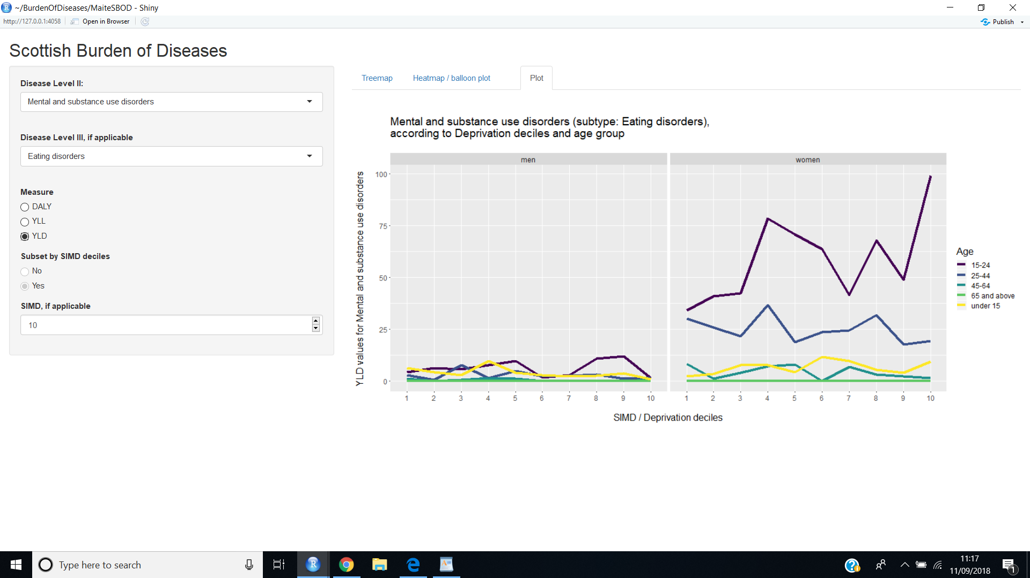
Scottish Burden of Diseases: Eating disorders by genre, age group and deprivation deciles ( Line plots by YLD)
SIMD: The Scottish Index of Multiple Deprivation
1 “Most deprived areas” and 10 “Least deprived areas”

Slide 30
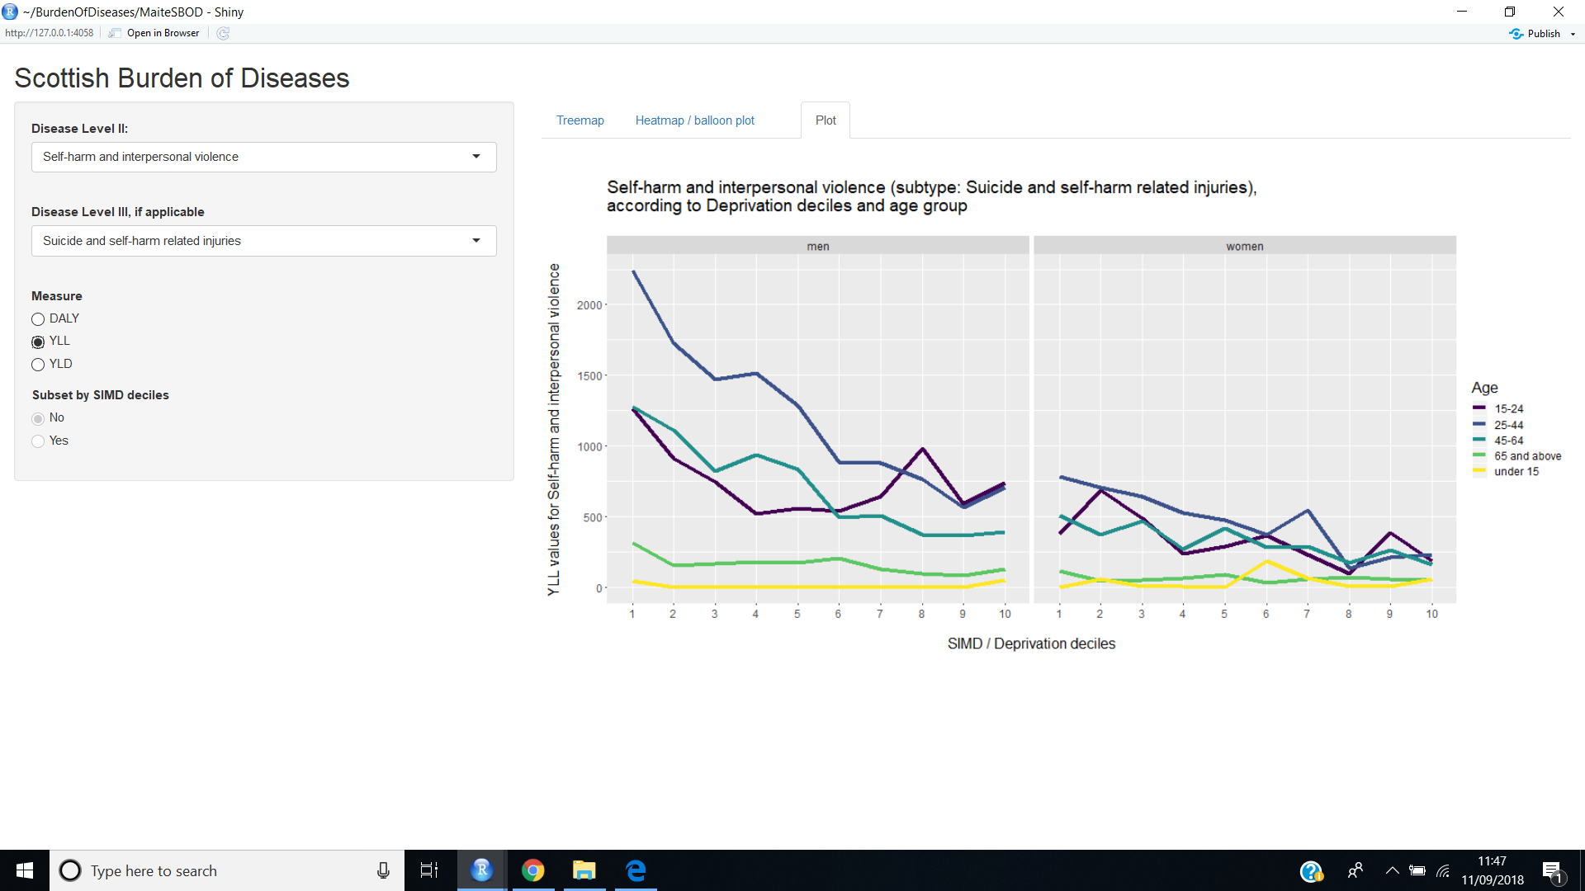
Scottish Burden of Diseases: Suicide and self-harm related injuries by genre, age group and deprivation deciles ( Line plots by YLL)
SIMD: The Scottish Index of Multiple Deprivation
1 “Most deprived areas” and 10 “Least deprived areas”

Slide 31
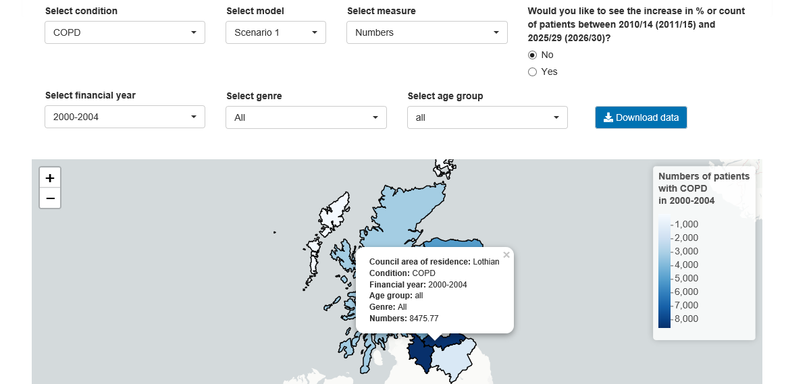
Long Term Conditions app (maps)

Slide 32
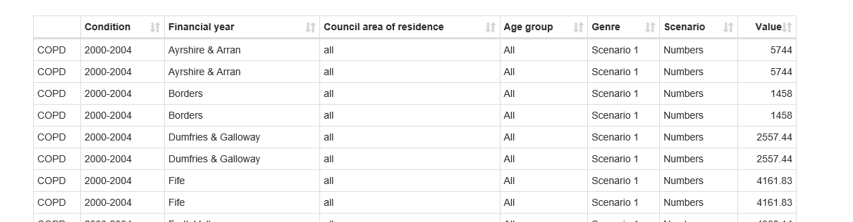
Long Term Conditions (tables)
Shiny tutorial: https://deanattali.com/blog/building-shiny-apps-tutorial/

